Slide 1





YOUNG STELLAR OBJECTS AND THEIR VARIABILITY WITH VERA RUBIN LSST
PI: Sara Bonito, INAF - Osservatorio Astronomico di Palermo
PI: Laura Venuti, SETI Institute, CA (USA)
co-Is:
Loredana Prisinzano, INAF - Osservatorio Astronomico di Palermo
Salvatore Orlando, INAF - Osservatorio Astronomico di Palermo
Mario Guarcello, INAF - Osservatorio Astronomico di Palermo
Teresa Giannini, INAF - Osservatorio Astronomico di Roma
Alessio Caratti o Garatti, INAF - Osservatorio Astronomico di Capodimonte
Nino Cucchiara, College of Marin (USA)
Rosaria (Sara) Bonito – INAF - Observatory of Palermo (Italy)

Slide 2

YSOs RUBIN LSST
Young stars with variability
(Bonito & Hartigan et al. 2018; Bonito & Venuti et al. 2021; Bonito & Venuti et al. ApJS in prep.):
Investigate stellar variability of single objects or in statistical samples in stellar clusters
Analyze variability due to stellar activity, accretion process, also in eruptive burst (FUors and EXors), etc.
Take advantage of data collected in existing surveys and previous programs (e.g. Pan-STARRS, Gaia-ESO Survey, Chandra) for a multi-band characterization
Sara Bonito – INAF - Observatory of Palermo (Italy)
Notes:
‹#›

Slide 3
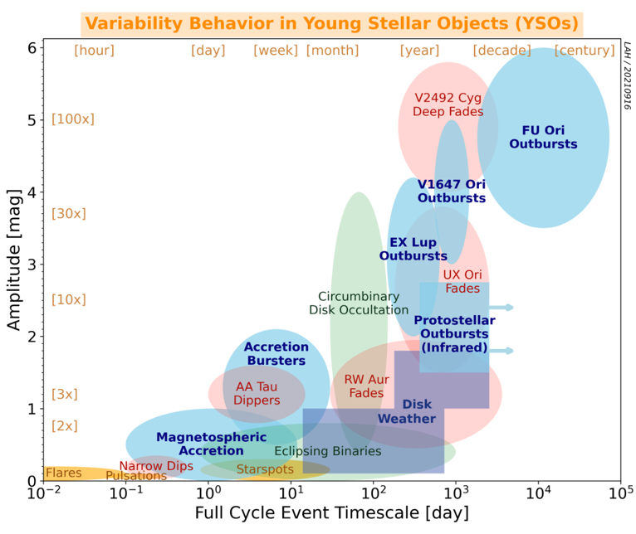
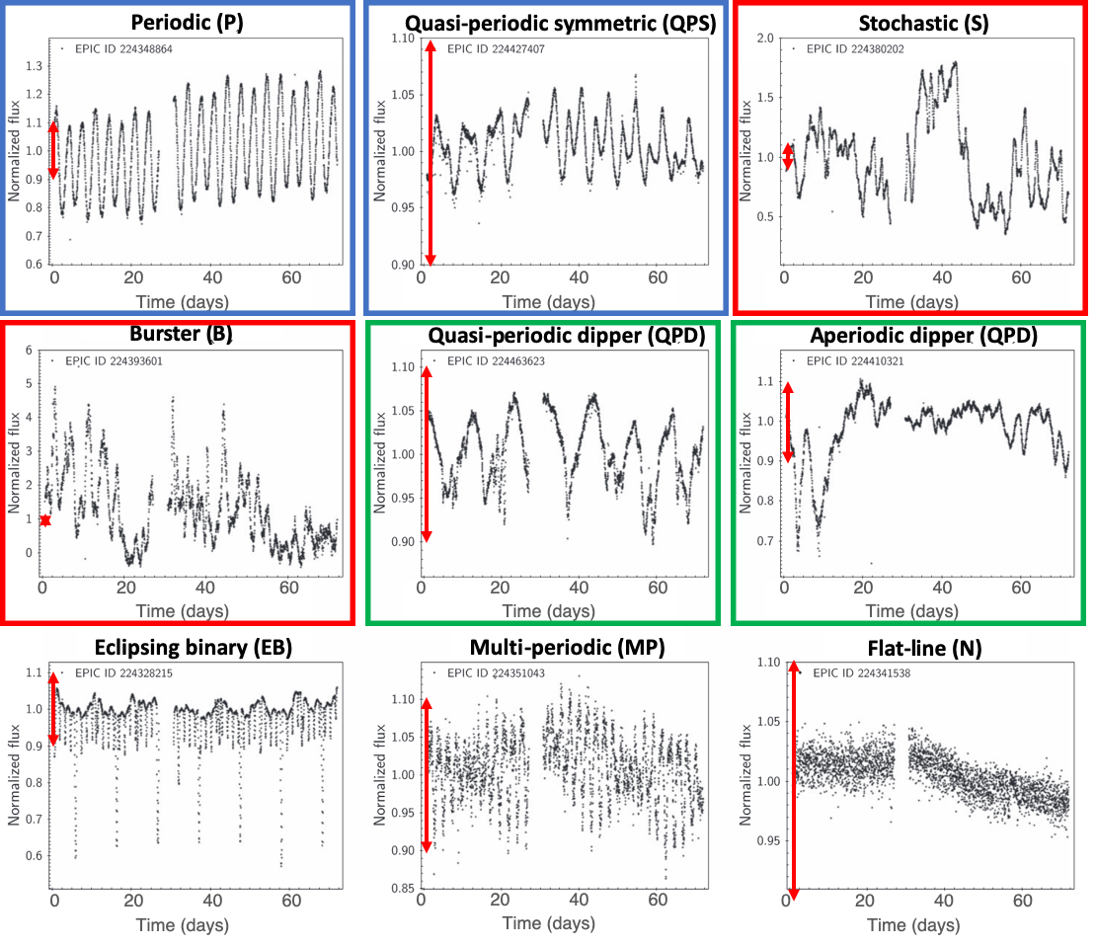
Young stellar objects
Sara (Rosaria) Bonito, INAF - OAPa
& Laura Venuti et al.
NGC 6530 stellar cluster - Kepler satellite
Fischer et al. 2022
Protostar & Planets VII
Variability at different timescales: from hours to years
Starspots, accretion, star-disk geometry
Overlapping interests in periodicity mining in LSST light-curves @AGN&GL Workshop, June 14 2022

Slide 4
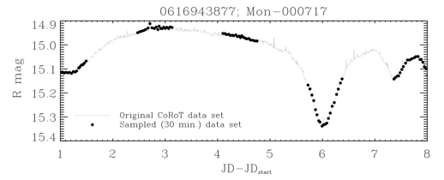
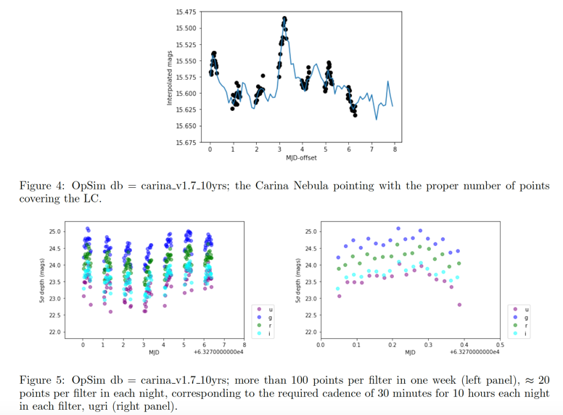
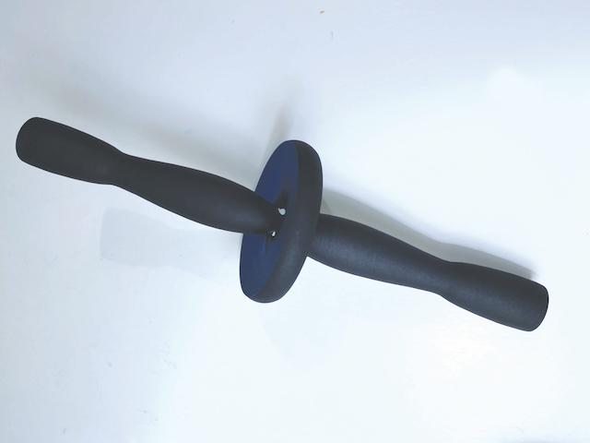
Young stellar objects
Sara (Rosaria) Bonito
& Laura Venuti et al.
Bonito & Hartigan et al. 2018
3D models and printed kits for a more inclusive Science with Rubin LSST:
to make more accessible our results to visually impaired students/researchers
project funded by Kickstarter Grant, Bonito & Venuti et al. (supported by the Preparing for Astrophysics with LSST Program)
Sabina Ustamujic
Bonito & Venuti et al. 2021
Overlapping interests in periodicity mining in LSST light-curves @AGN&GL Workshop, June 14 2022

Slide 5
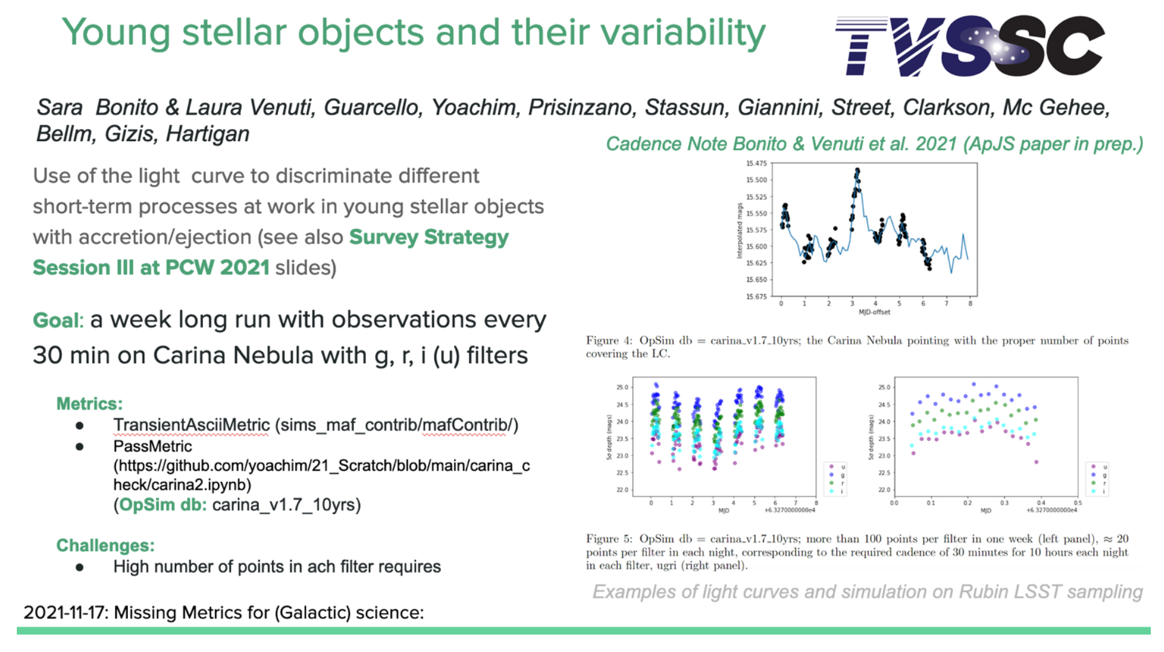
each filter

Slide 6
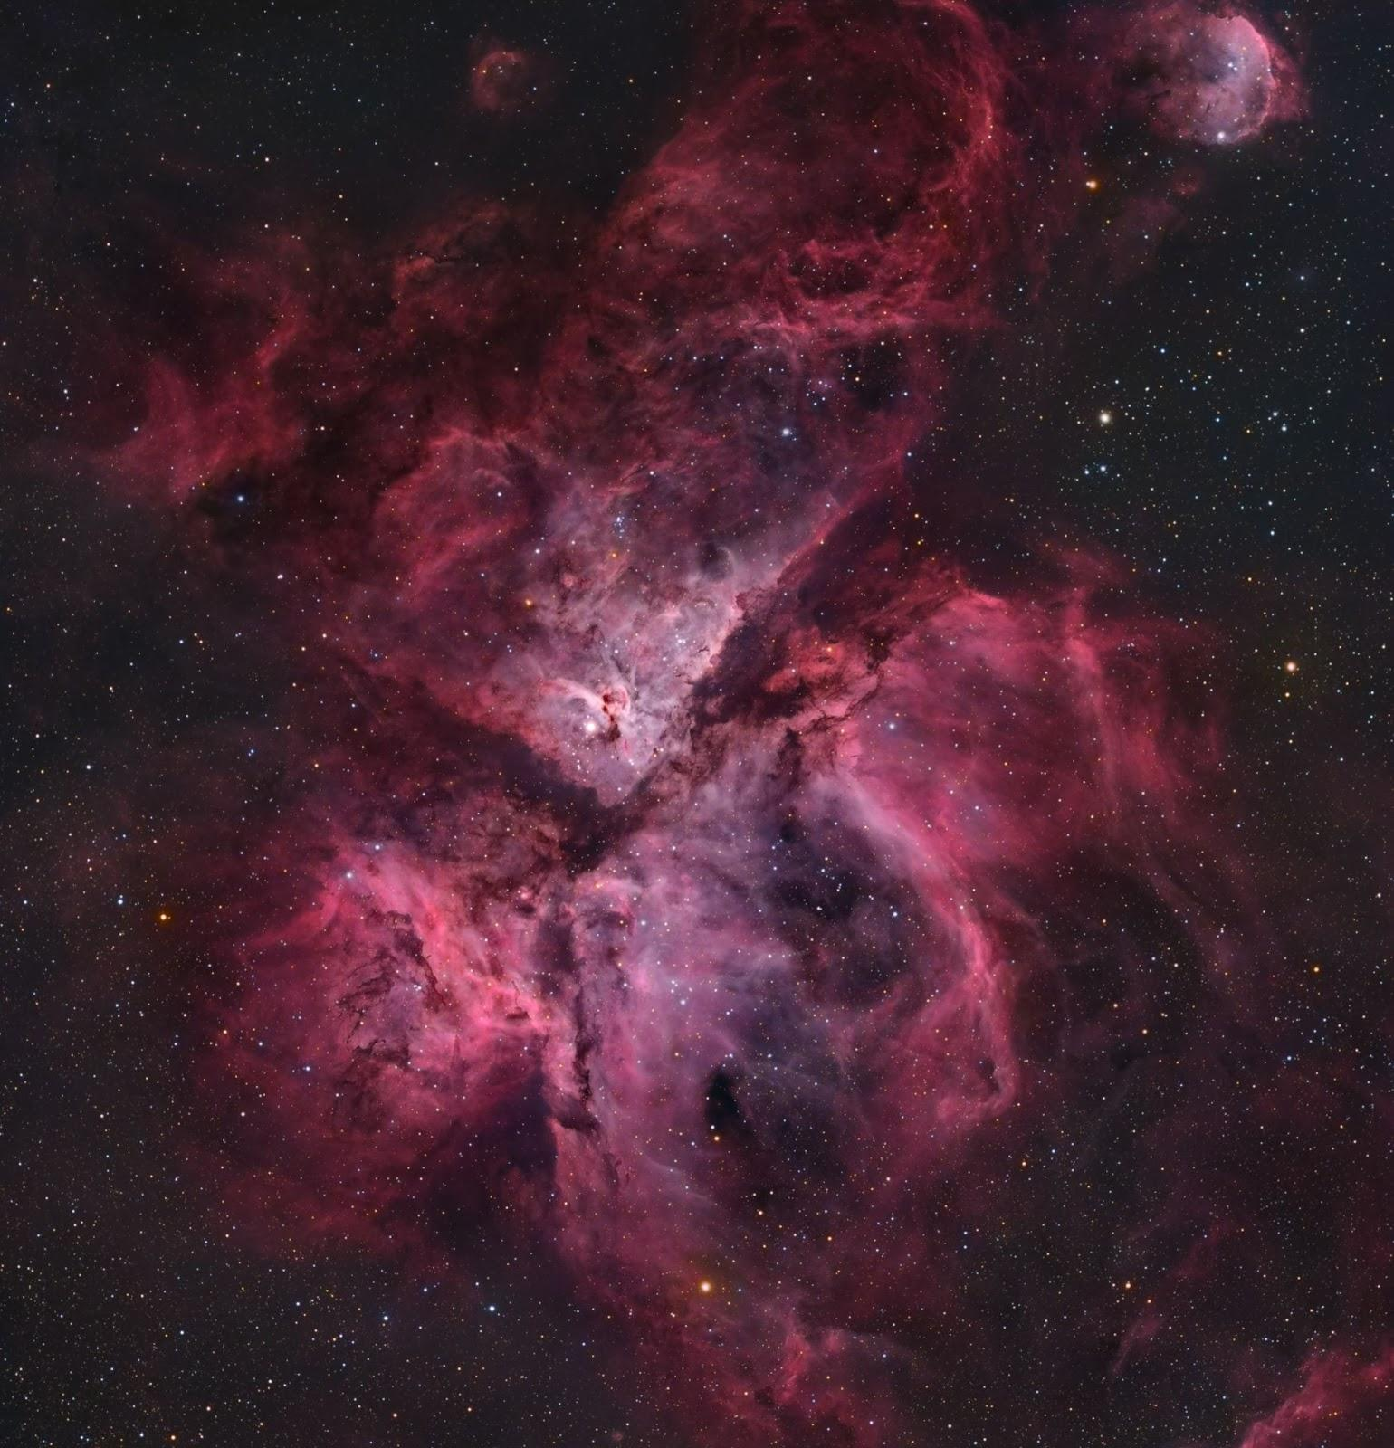

DDFs: TVS Science Objectives
Star Forming Regions
Multiple DDFs located on Star Forming Regions, starting with the Carina Nebula
Intensive timeseries observations
Mass accretion, stellar activity cycles, flares and outbursts
Bonito & Hartigan et al. 2018
Baseline v2.0:
Intensive obs conducted annually, multiple SFRs
Advise including in survey strategy sooner than Phase 2
Vera C. Rubin Observatory | 2nd SCOC Workshop Community Session | 17 November 2021

Slide 7
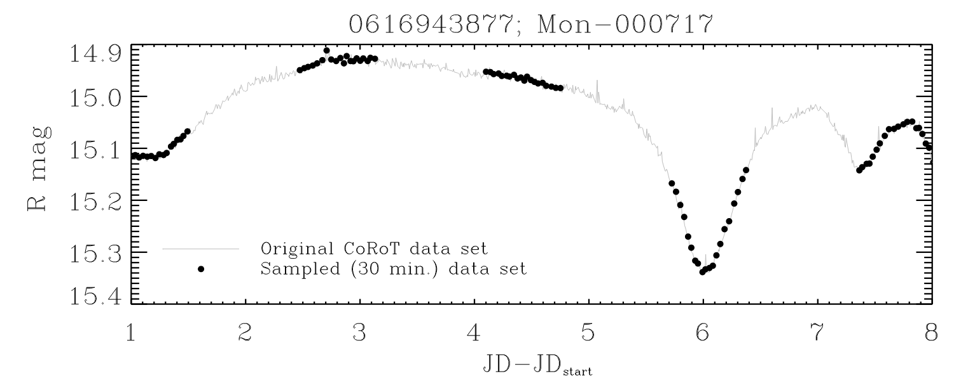
DDFs: TVS Science Objectives
Star Forming Regions
Multiple DDFs located on Star Forming Regions, starting with the Carina Nebula
Intensive timeseries observations
Mass accretion, stellar activity cycles, flares and outbursts
Baseline v2.0:
Intensive obs conducted annually, multiple SFRs
Advise including in survey strategy sooner than Phase 2
Bonito & Hartigan et al. 2018
Vera C. Rubin Observatory | 2nd SCOC Workshop Community Session | 17 November 2021

Slide 8
DDFs: TVS Science Objectives
Star Forming Regions
Multiple DDFs located on Star Forming Regions, starting with the Carina Nebula
Intensive timeseries observations
Mass accretion, stellar activity cycles, flares and outbursts
Non degenerate eruptive variables (NDEV) group
chair Sara (Rosaria) Bonito
Baseline v2.0:
Intensive obs conducted annually, multiple SFRs
Advise including in survey strategy sooner than Phase 2
Bonito & Hartigan et al. 2018
Vera C. Rubin Observatory | 2nd SCOC Workshop Community Session | 17 November 2021

Slide 9
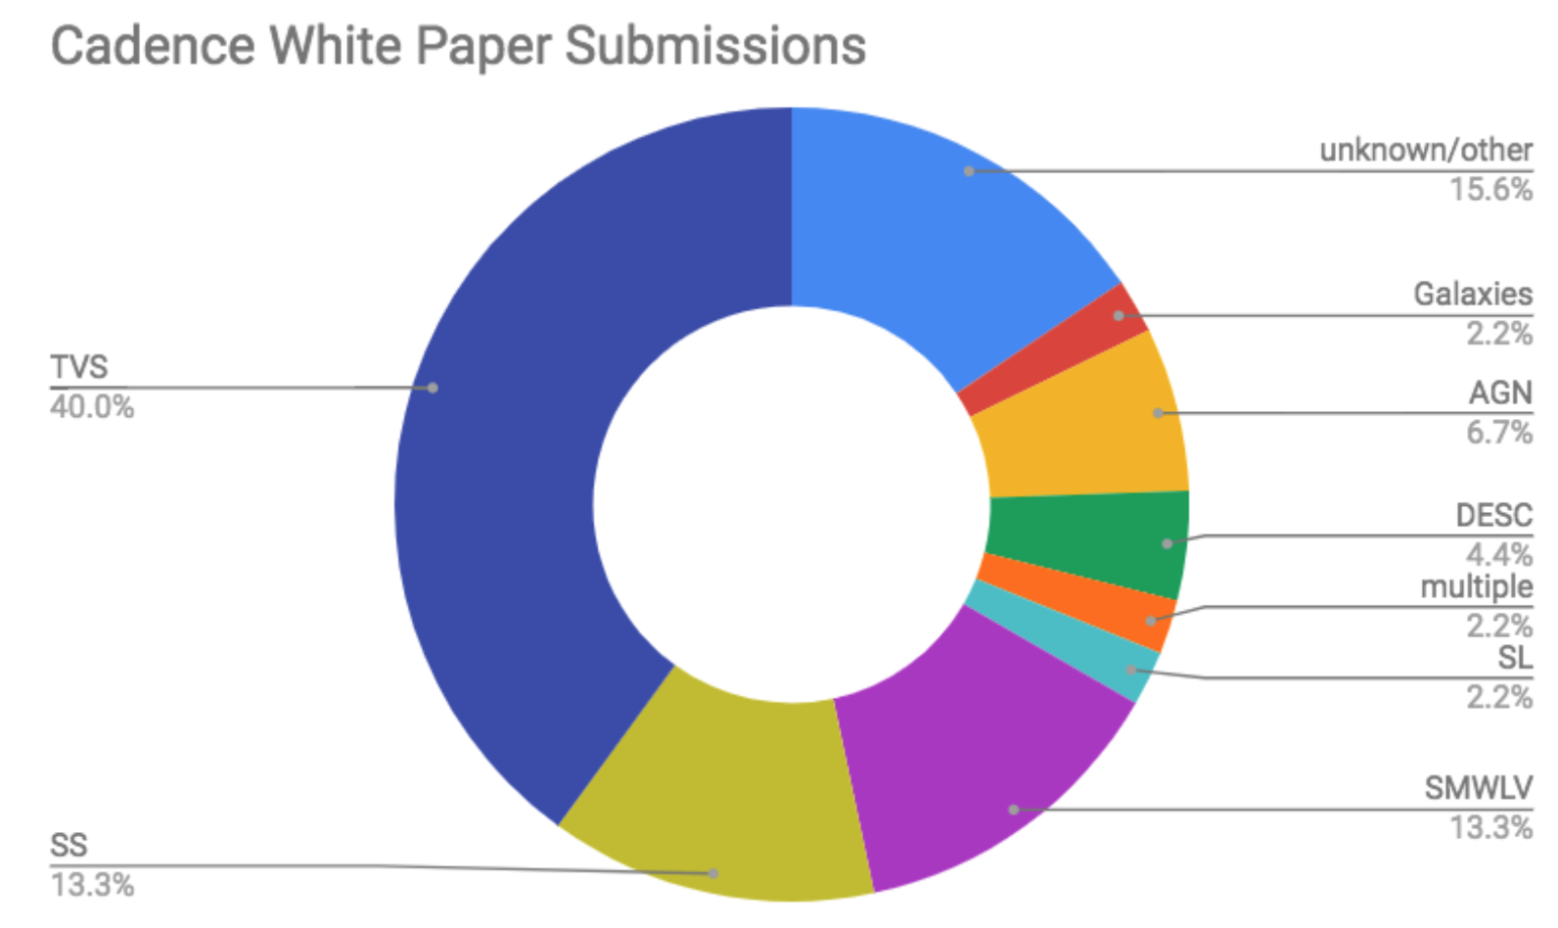
RUBIN OBSERVATORY
TVS Deep-drilling fields and mini-surveys proposals planning
Task Force 2018
(Chair: Sara Bonito)
Image Credit: Federica Bianco
Transients and Variable Stars
Stars Milky Way and Local Volume
Content
https://www.lsst.org/submitted-whitepaper-2018
Rosaria (Sara) Bonito

Slide 10
RUBIN OBSERVATORY
TVS/SMWLV Cadence Note
Task Force 2020-2022
(Chair:
Rachel Street/Will Clarkson)
Rubin LSST Observing Strategy
Cadence Notes 2021/ApJS 2021-2022
https://www.lsst.org/content/survey-cadence-notes-2021
Simulations of the metrics
Hackathon days (Will Clarkson – co-Chair SMWLV)
Rosaria (Sara) Bonito – INAF - Observatory of Palermo (Italy)

Slide 11
RUBIN SCIENCE PLATFORM
Rosaria (Sara) Bonito – INAF - Observatory of Palermo (Italy)

Slide 12
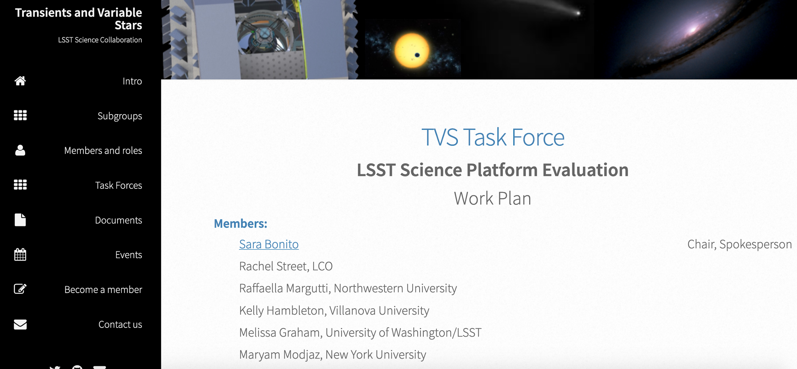
RUBIN OBSERVATORY
TVS Science Platform Evaluation Task Force 2019-2020
(Chair: Sara Bonito)
More members,
from a very diverse range of
scientific interests
Rosaria (Sara) Bonito – INAF - Observatory of Palermo (Italy)

Slide 13
Data Preview 0 Task Force (DP0 TF)
chair Sara (Rosaria) Bonito
co-chair Vincenzo Petrecca
- telecon: also tutorials for the use of Portal and notebooks
- active participation (breakout room requested) during the DP0 Assembly and the Stack Club: every Friday
- internship for undergrad students
Rosaria (Sara) Bonito – INAF - Observatory of Palermo (Italy)

Slide 14
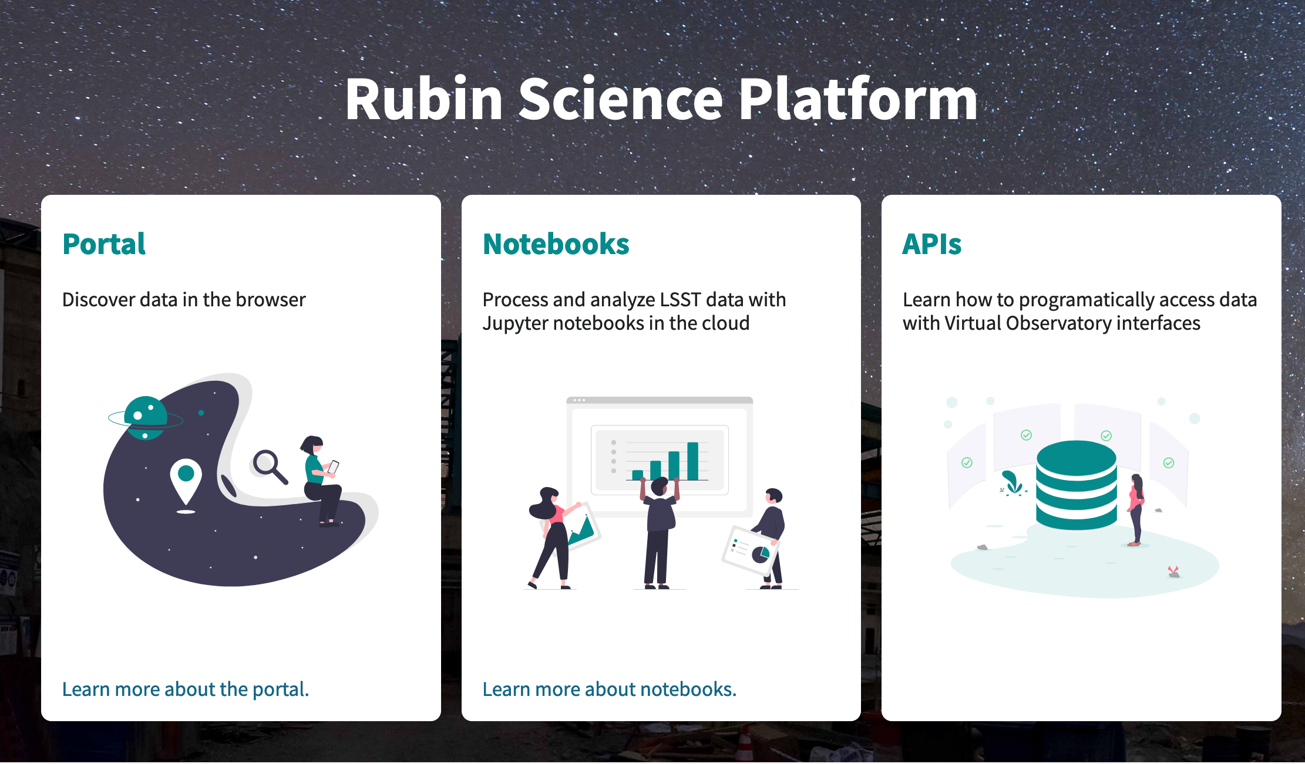
Rosaria (Sara) Bonito – INAF - Observatory of Palermo (Italy)

Slide 15
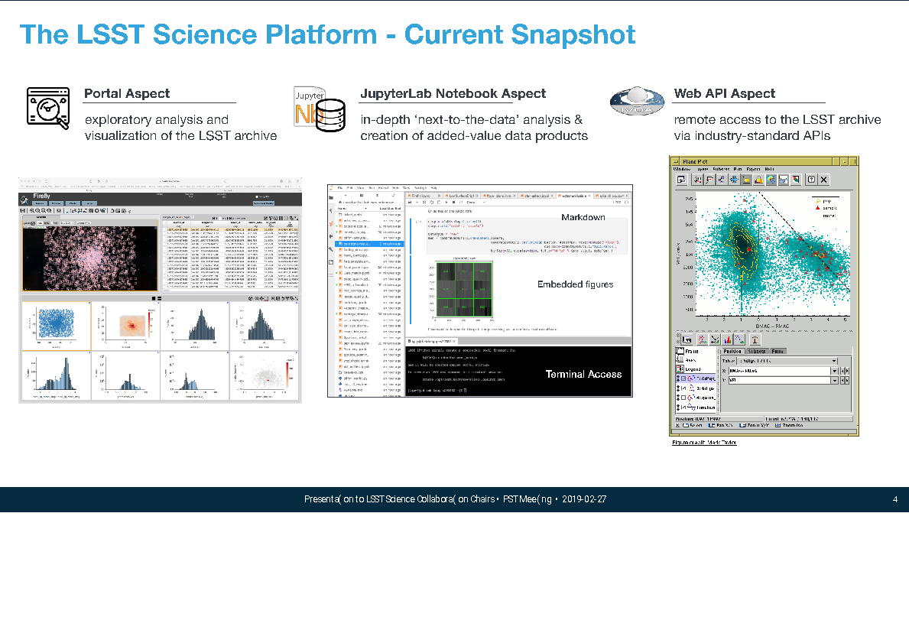
LSST SCIENCE PLATFORM
Rosaria (Sara) Bonito – INAF - Observatory of Palermo (Italy)
Notes:
3 aspetti, ma solo Portal e Noiteboook attivi
Portal l’ho usato solo io finora a detta loro

Slide 16
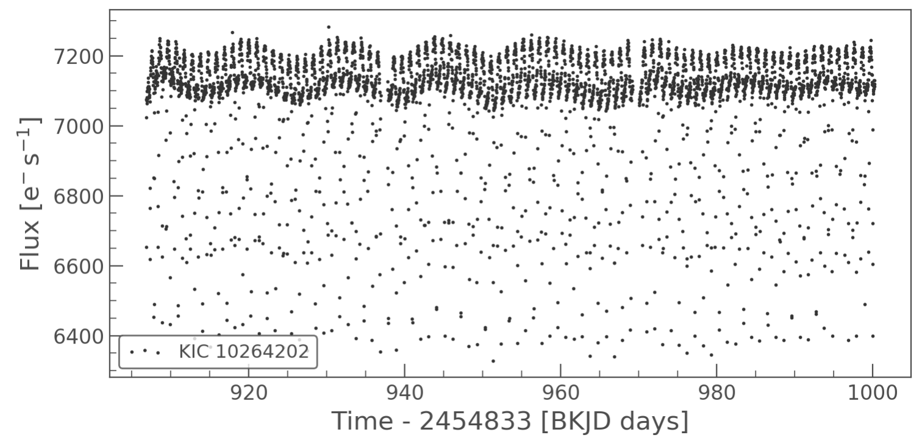
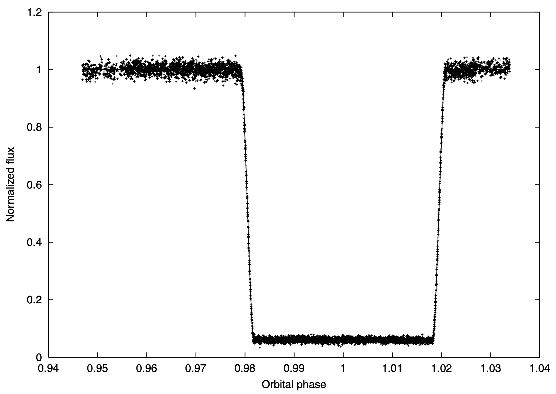
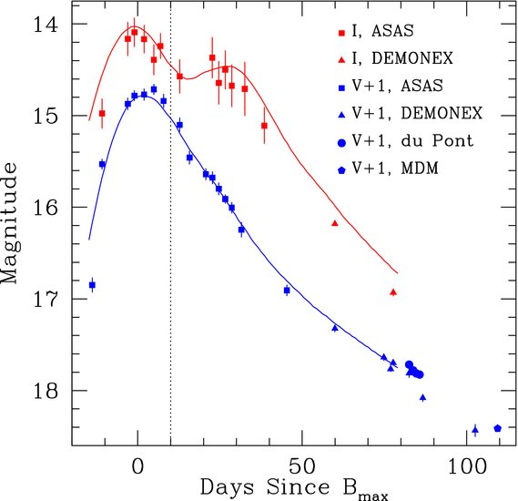
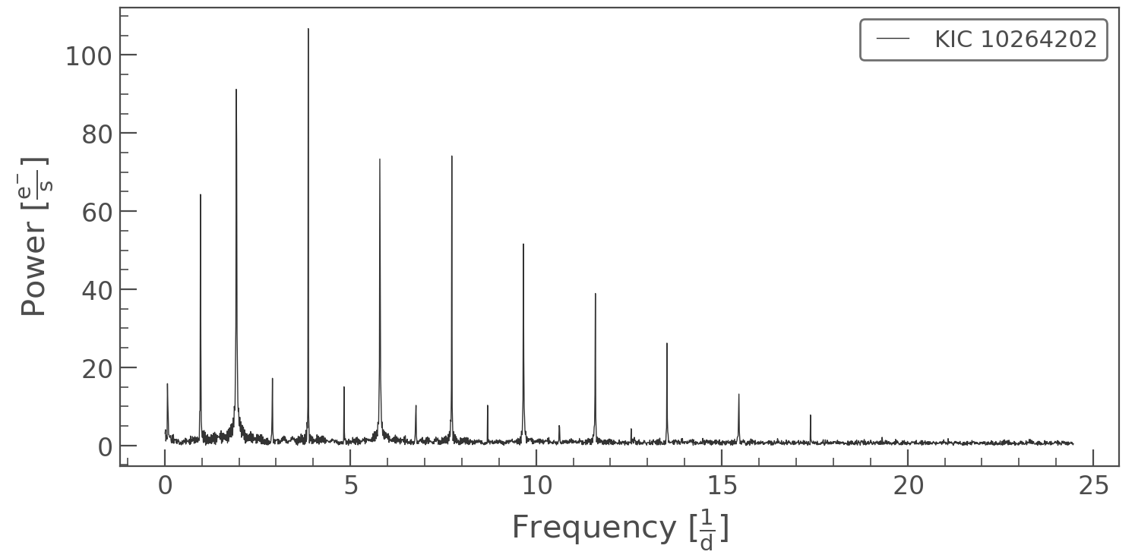
Lightcurve analysis
RUBIN OBSERVATORY
Much of TVS science will depend on analysing and modeling lightcurves
Extensive software already exists for this purpose
Graphics: Lightkurve.org, Maxted et al., 2004, MNRAS, 355, 1143, Khan, R. et al. (2010), ApJ, 726, 106
Rosaria (Sara) Bonito – courtesy of Rachel Street

Slide 17
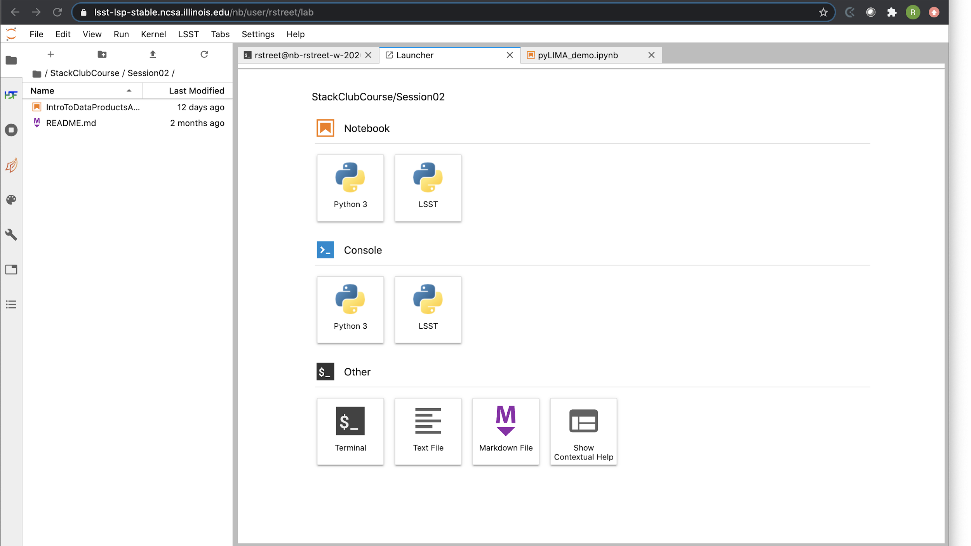
Lightcurve modeling in the RSP
RUBIN OBSERVATORY
Notebook aspect of RSP offers both Jupyter Notebook and a terminal
Rosaria (Sara) Bonito – courtesy of Rachel Street

Slide 18
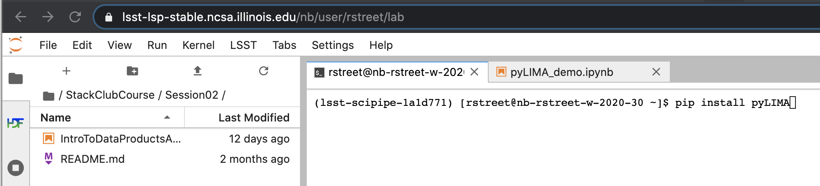
Lightcurve modeling in the RSP
RUBIN OBSERVATORY
User accounts provide 100GB of storage and a virtual python environment where users can install their own software, e.g. via pip or clone from Github
Rosaria (Sara) Bonito – courtesy of Rachel Street

Slide 19
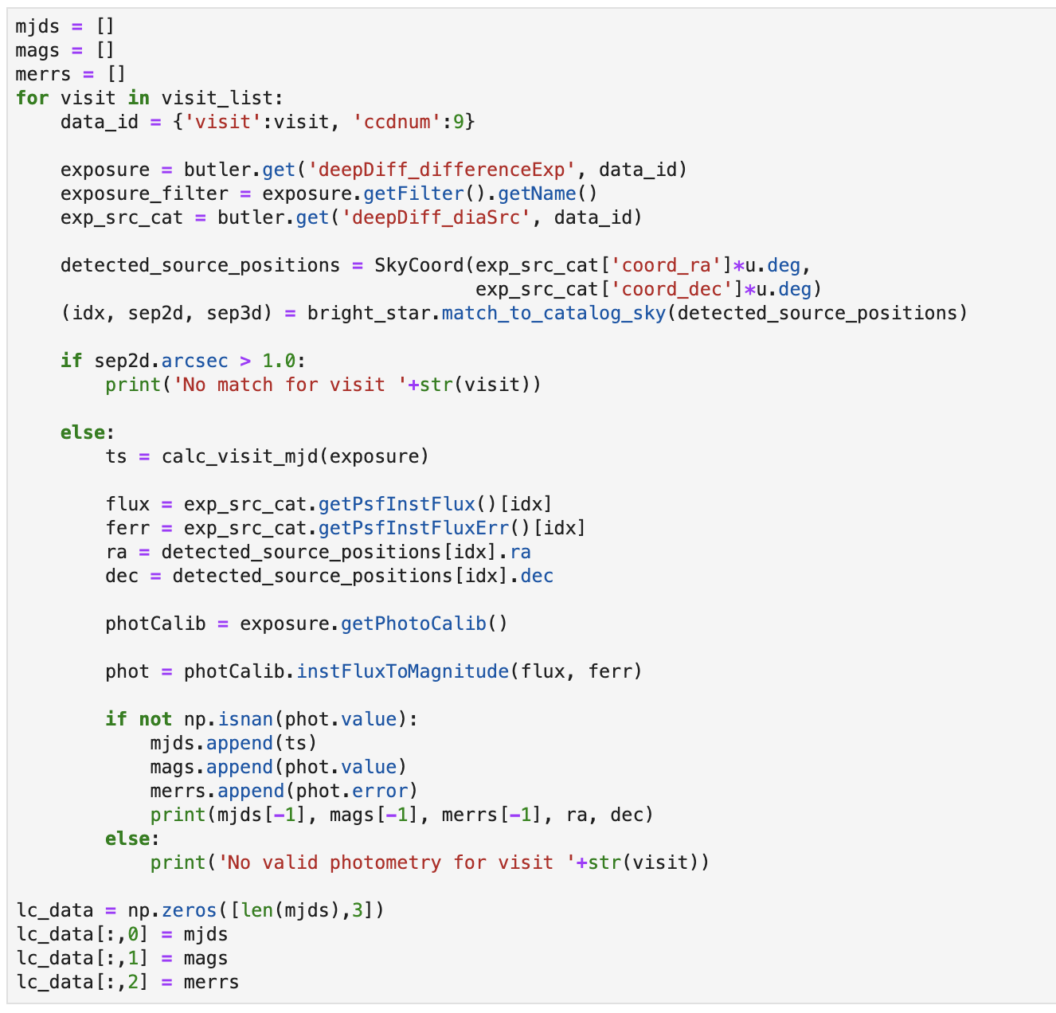
Building lightcurves
RUBIN OBSERVATORY
Data served by data Butler system
Rubin LSST data products are organized on a per-image basis
Lightcurves must be built by extracting flux data for each object from the source catalog from each image of a set
Rosaria (Sara) Bonito – courtesy of Rachel Street

Slide 20
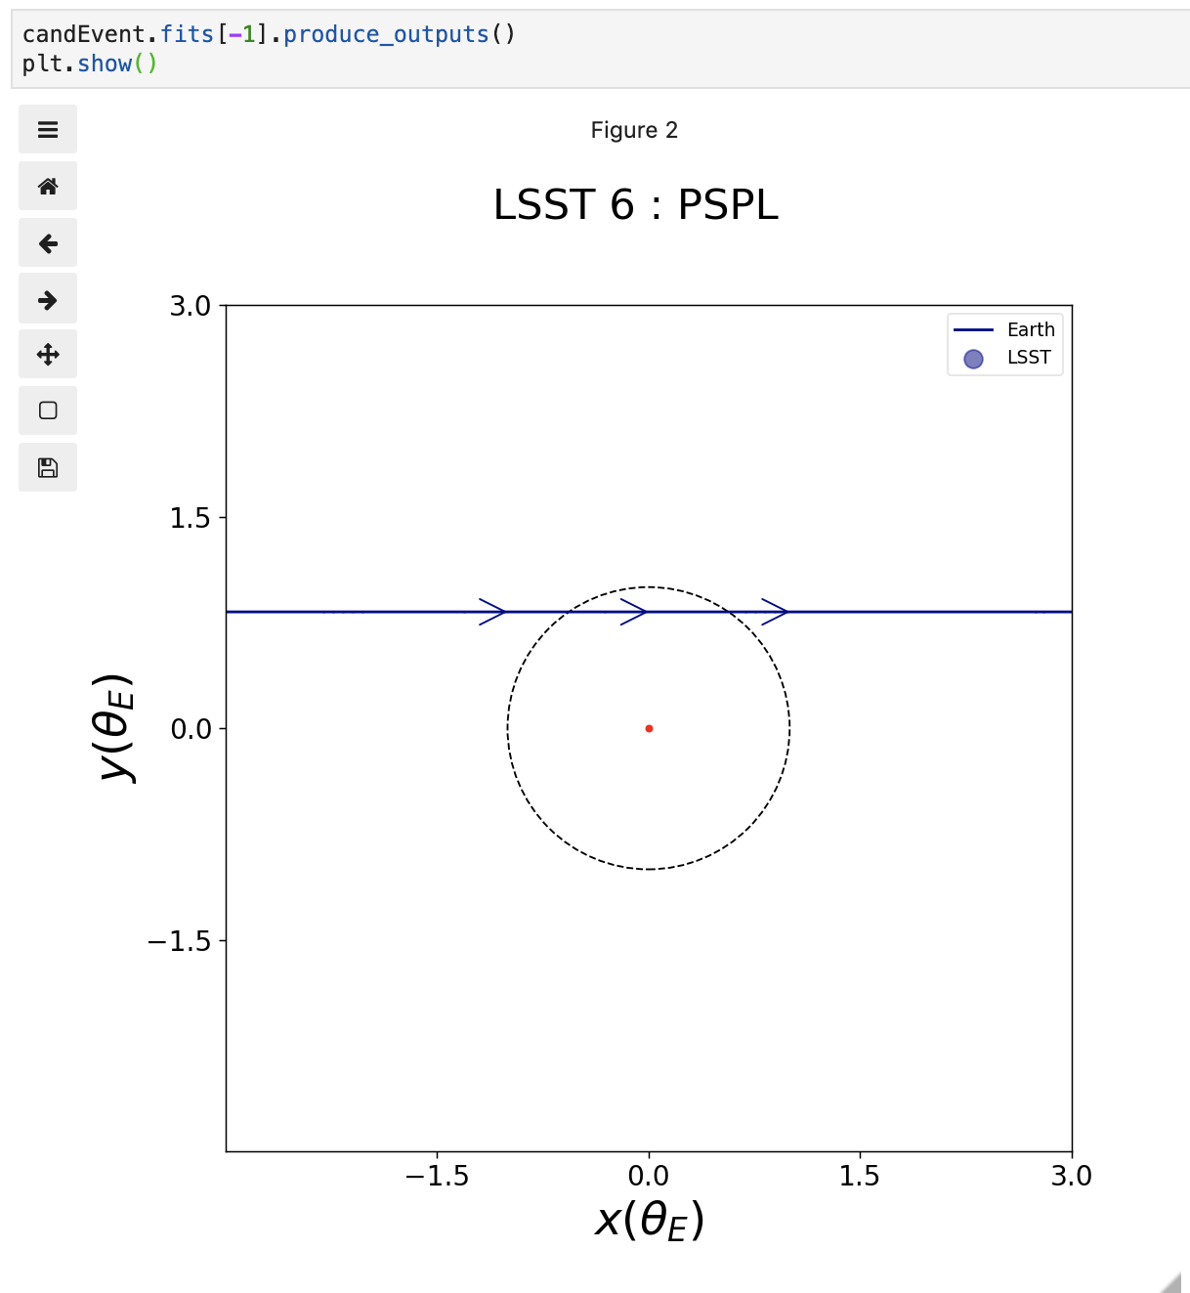
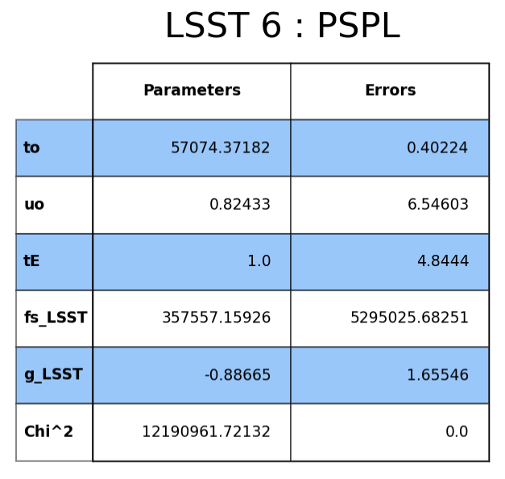
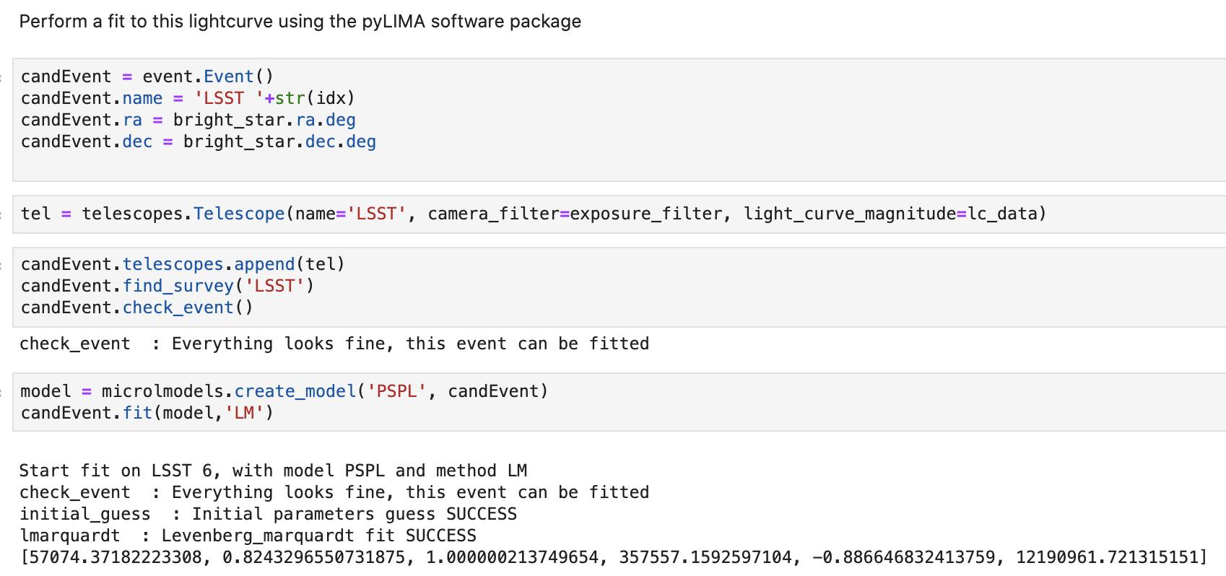
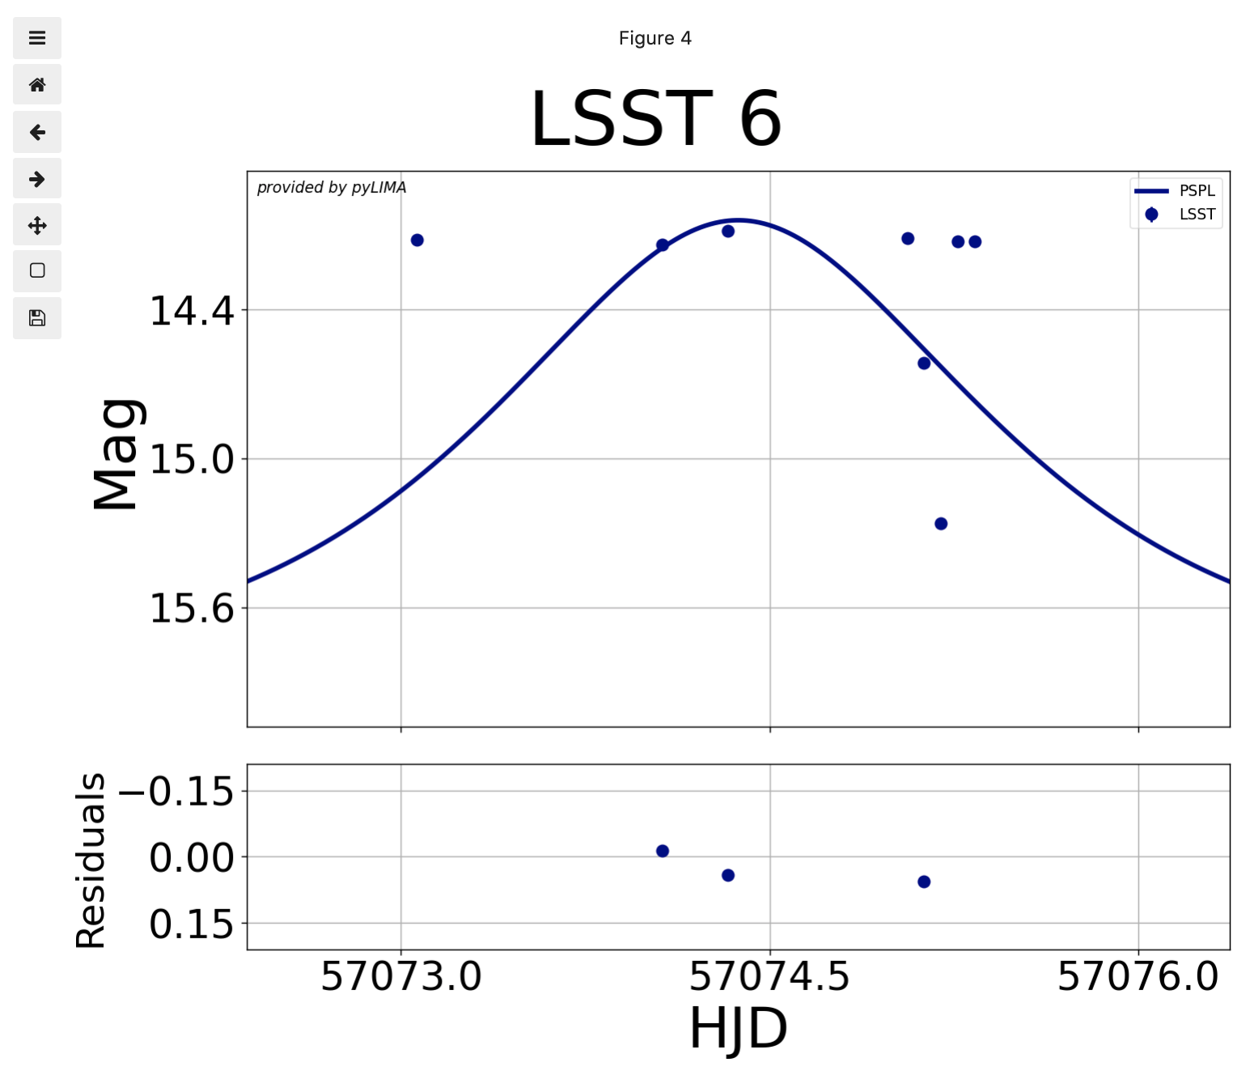
Modeling lightcurves
RUBIN OBSERVATORY
Example of a lightcurve modeling procedure and products, using the pyLIMA software within the RSP Notebook aspect
Rosaria (Sara) Bonito – courtesy of Rachel Street

Slide 21
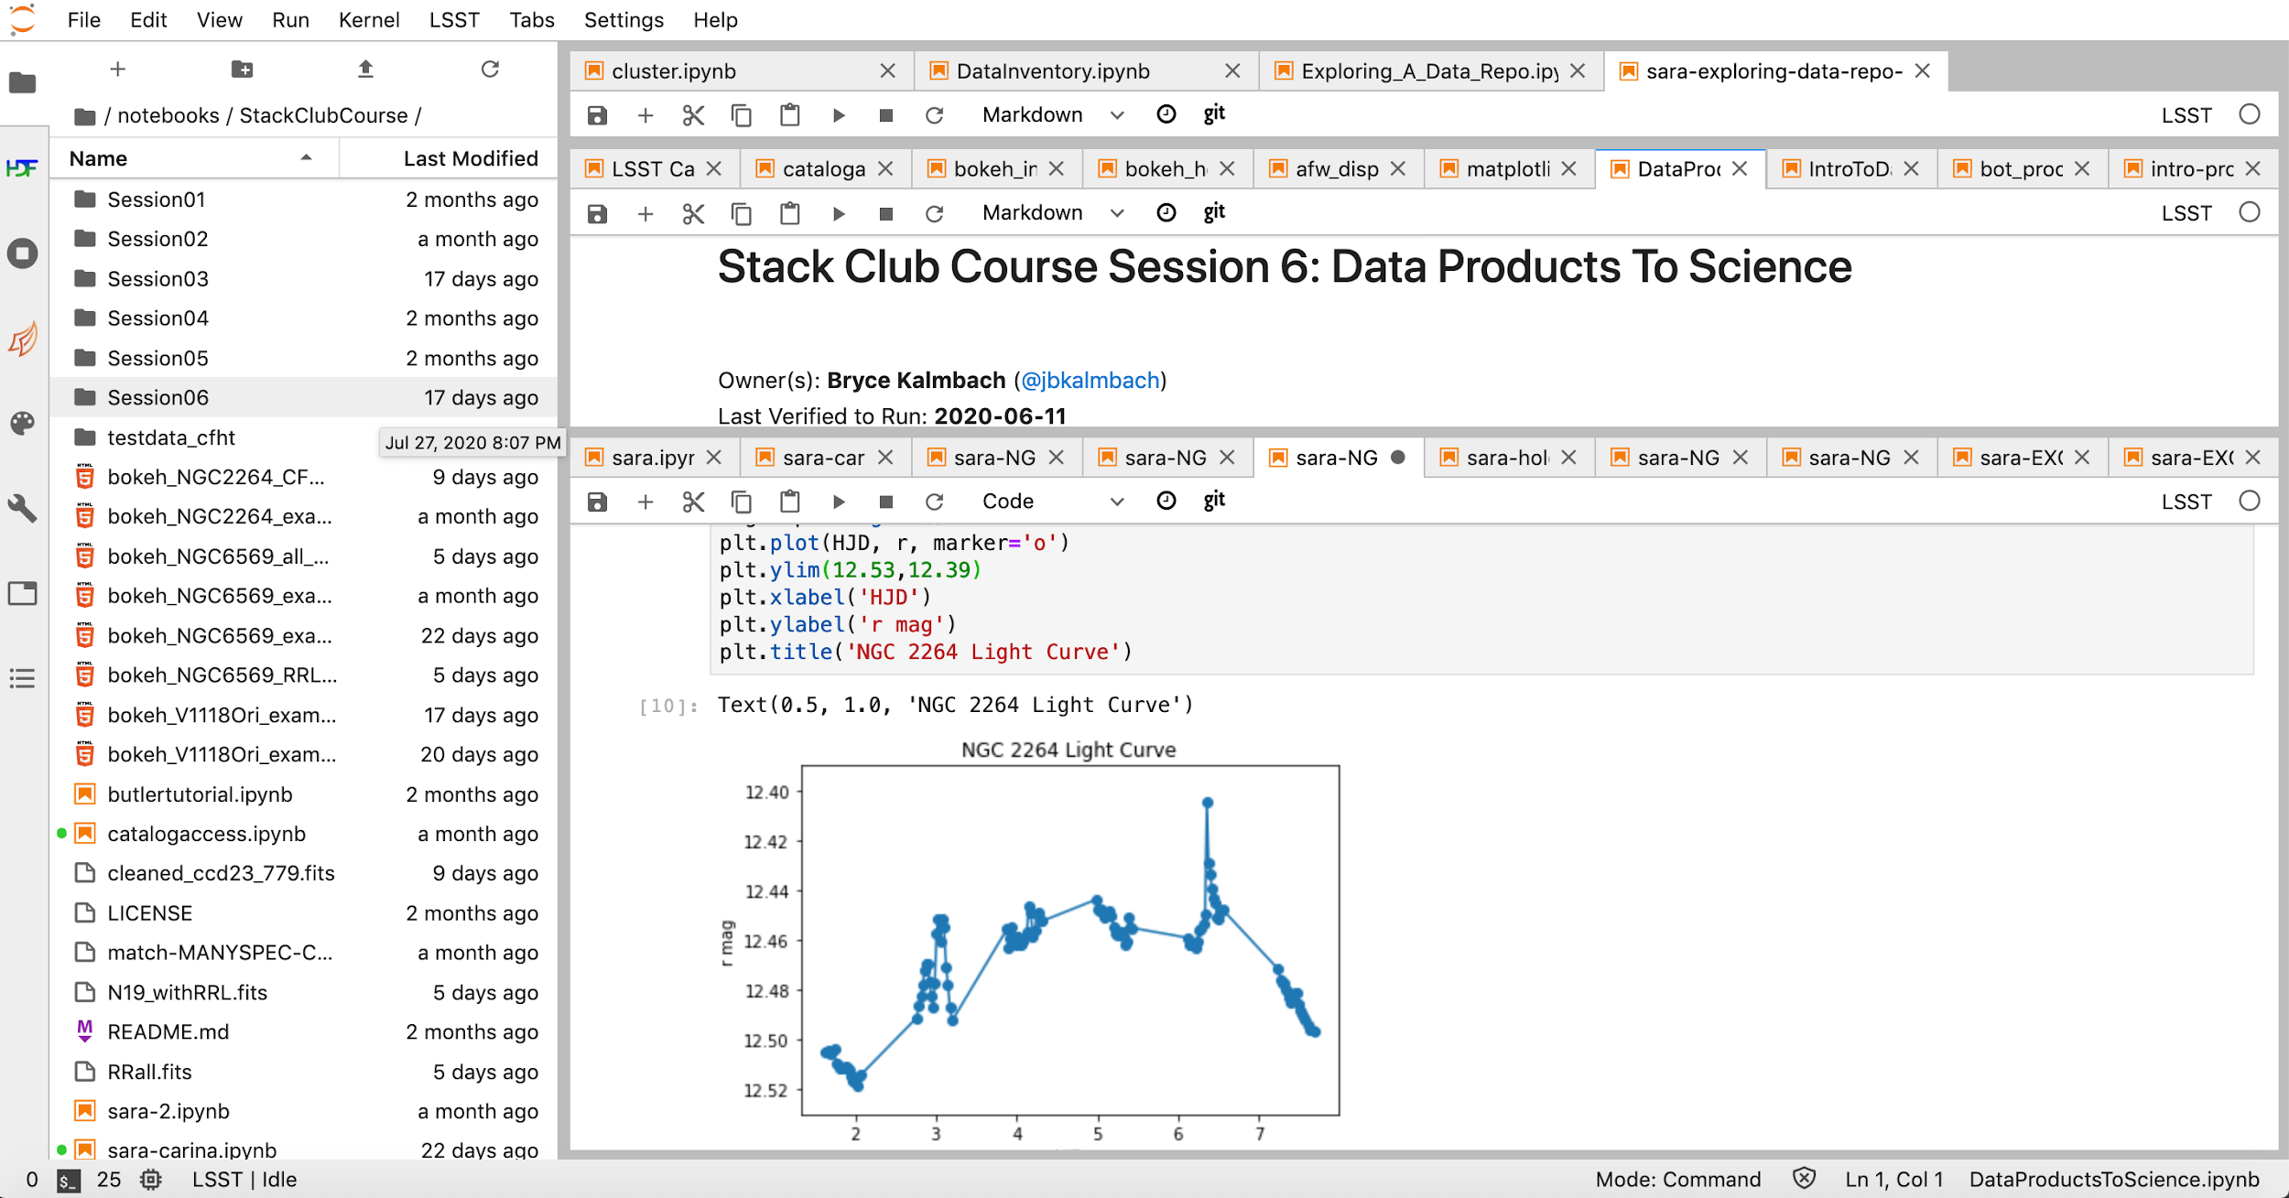
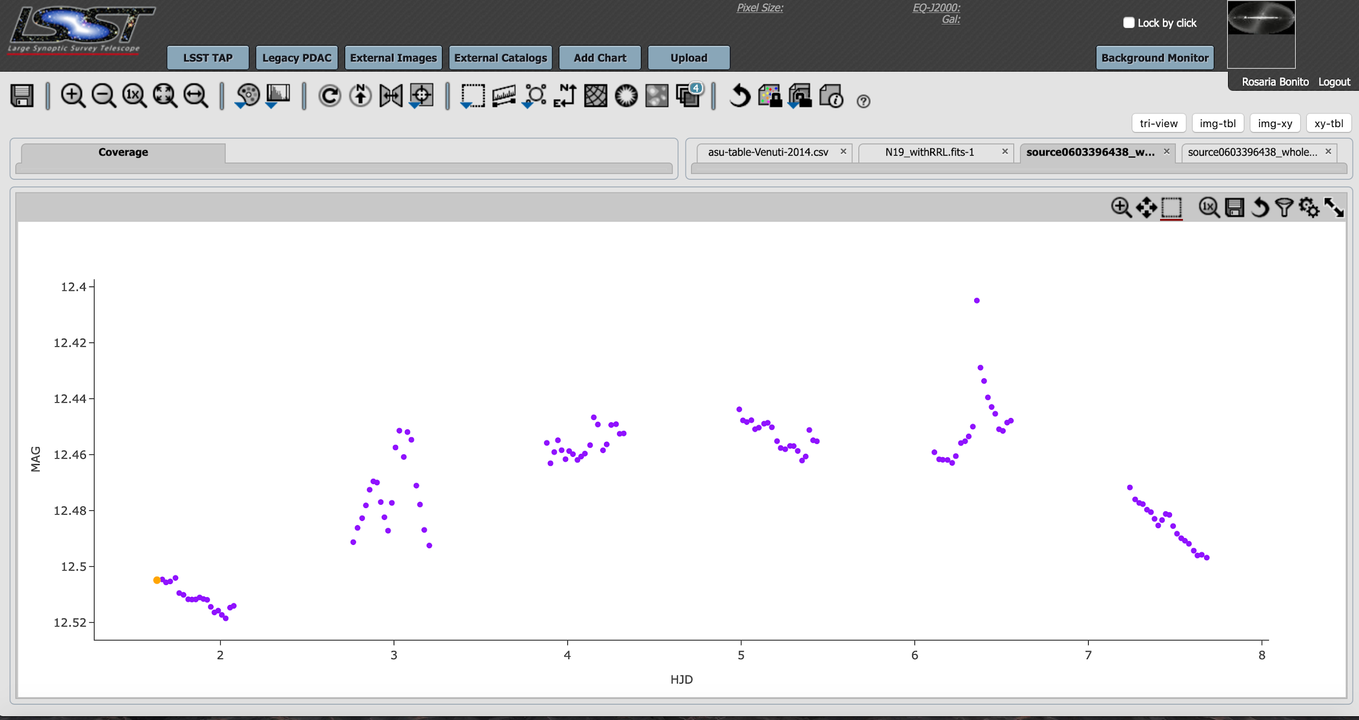
RUBIN OBSERVATORY
NGC 2264 YOUNG CLUSTER
Bonito & Hartigan et al. 2018 (WP for Rubin LSST Cadence Optimization)
Discussed during PCW2020 Metrics Hackathon
Bonito & Hartigan et al. 2018 (WP for Rubin LSST Cadence Optimization)
Rosaria (Sara) Bonito – INAF - Observatory of Palermo (Italy)

Slide 22
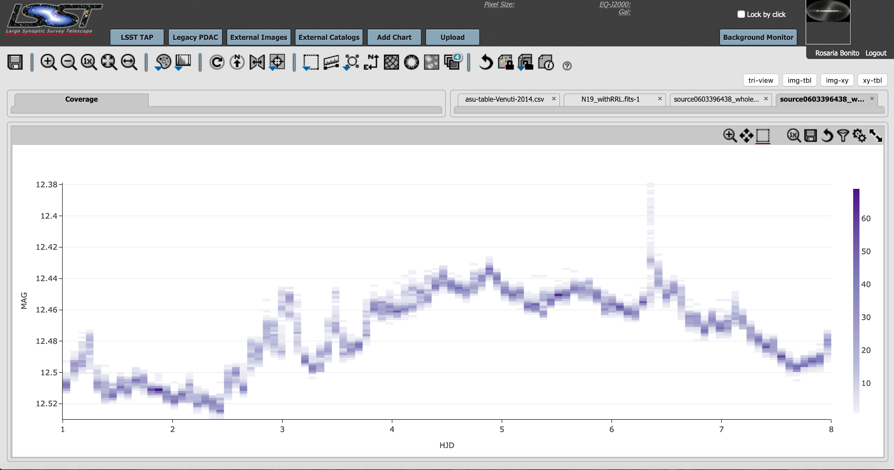
RUBIN OBSERVATORY
NGC 2264 YOUNG CLUSTER
Bonito & Hartigan et al. 2018 (WP for Rubin LSST Cadence Optimization)
Rosaria (Sara) Bonito – INAF - Observatory of Palermo (Italy)

Slide 23
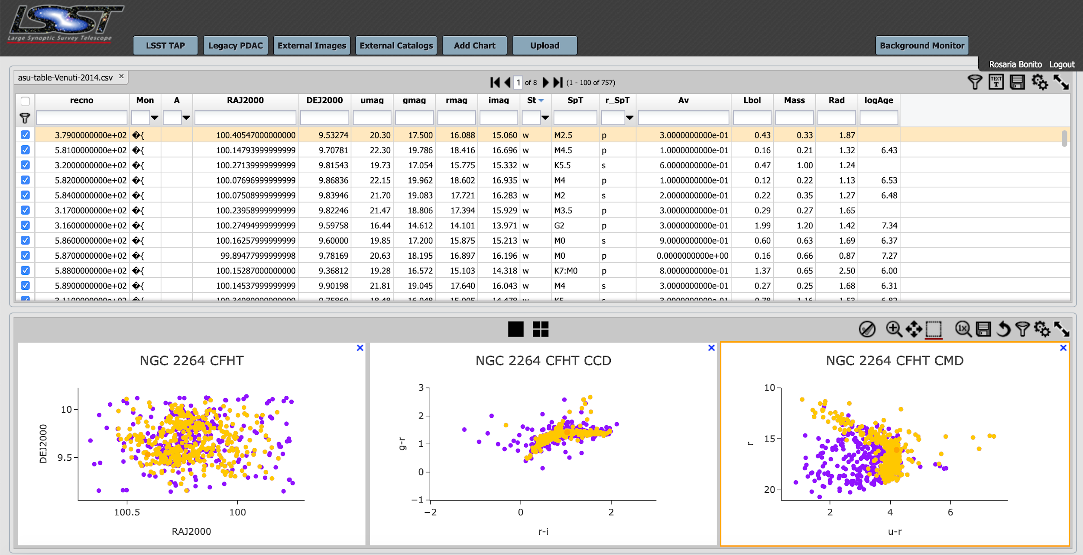
RUBIN OBSERVATORY
Rosaria (Sara) Bonito – INAF - Observatory of Palermo (Italy)
Venuti et al. 2014

Slide 24
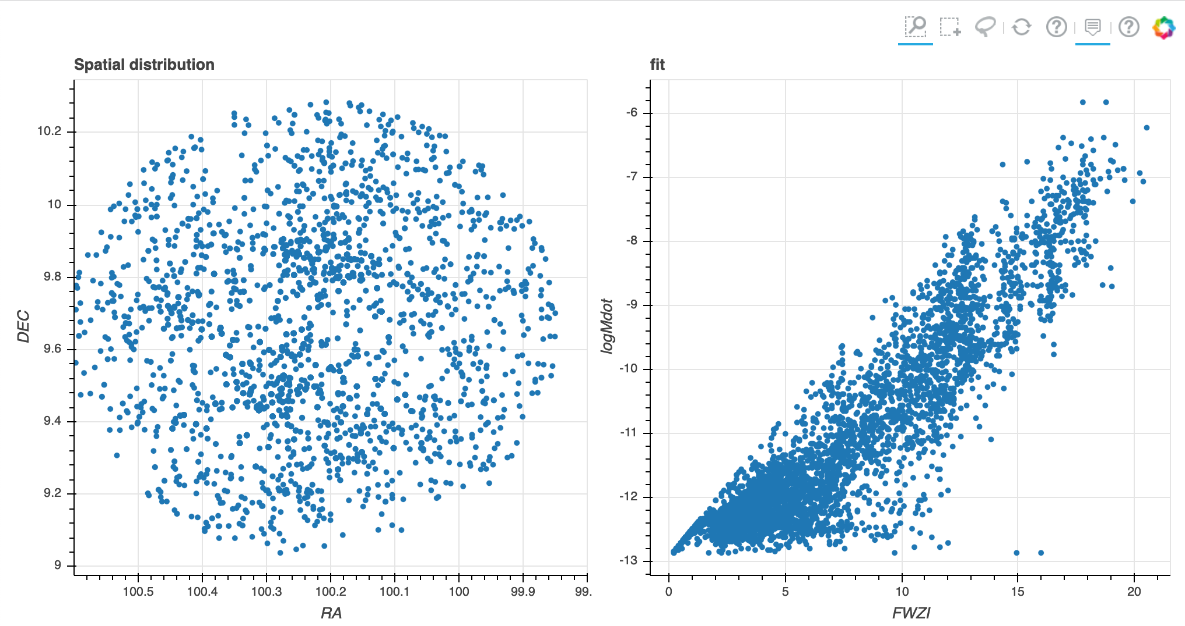
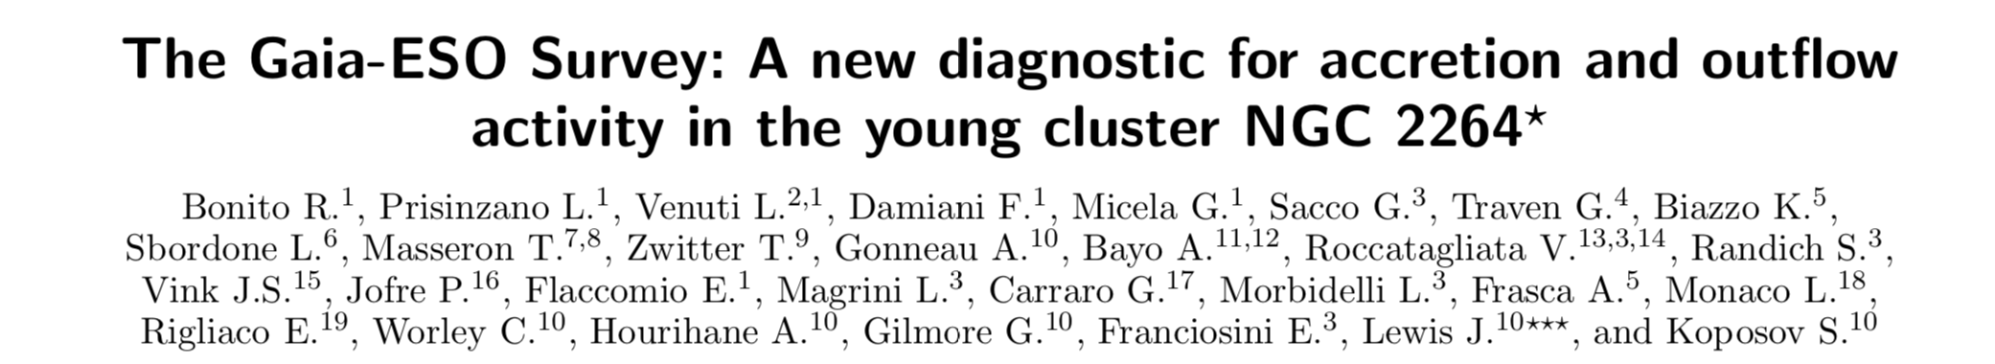
NGC 2264 YOUNG CLUSTER
Bonito et al. 2020, in press
Bonito & Hartigan et al. 2018 (WP for Rubin LSST Cadence Optimization)
file:///Users/administrator/Desktop/LAVORO%20AGILE%202020/VERA-RUBIN-LSST/STACK-CLUB/STACK-CLUB-COURSE/STACK-CLUB-COURSE-GRUPPO-4/NGC2264/bokeh_NGC2264_example(2).html
Rosaria (Sara) Bonito – INAF - Observatory of Palermo (Italy)

Slide 25
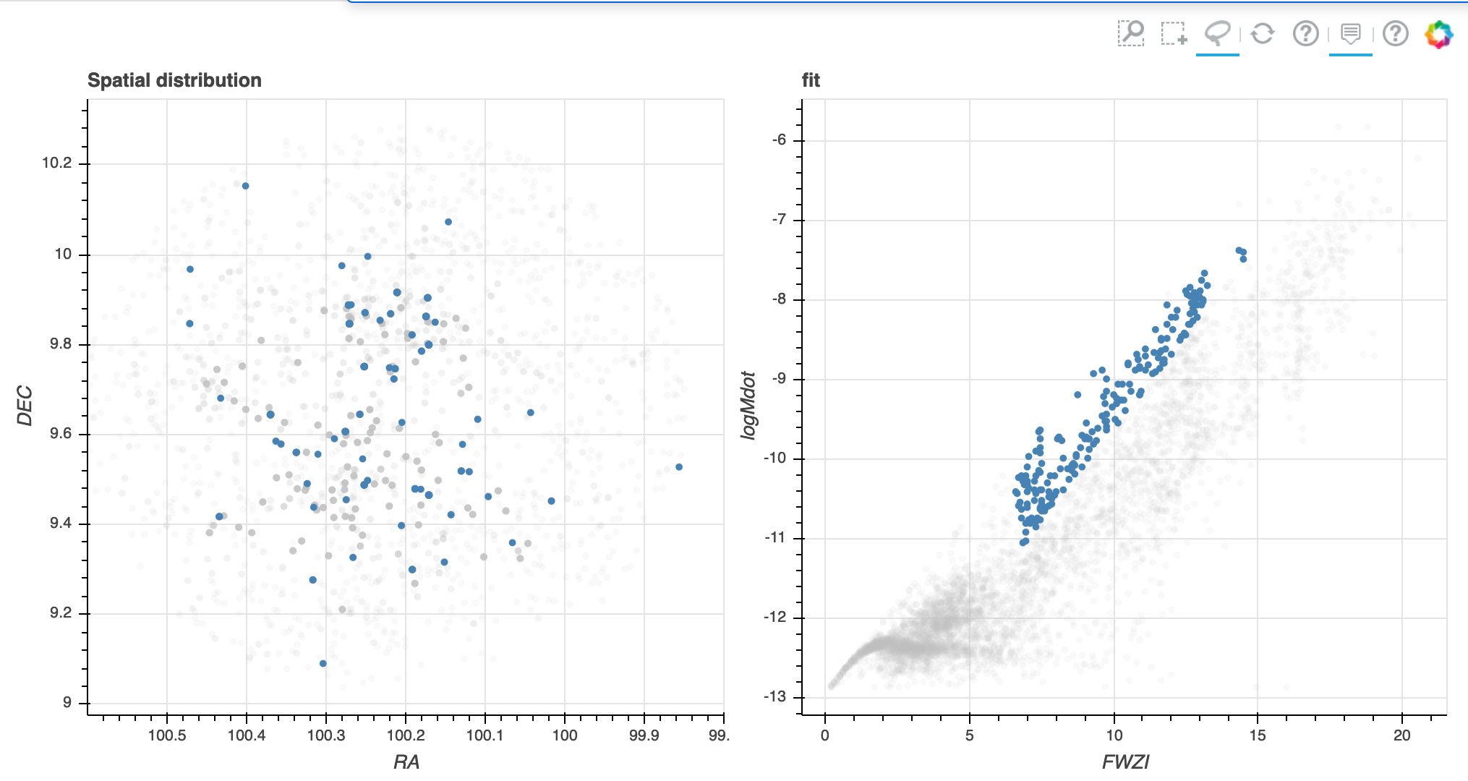
NGC 2264 YOUNG CLUSTER
Bonito et al. 2020, in press
Bonito & Hartigan et al. 2018 (WP for Rubin LSST Cadence Optimization)
file:///Users/administrator/Desktop/LAVORO%20AGILE%202020/VERA-RUBIN-LSST/STACK-CLUB/STACK-CLUB-COURSE/STACK-CLUB-COURSE-GRUPPO-4/NGC2264/bokeh_NGC2264_example(2).html
Rosaria (Sara) Bonito – INAF - Observatory of Palermo (Italy)

Slide 26
NGC 2264 YOUNG CLUSTER
file:///Users/administrator/Desktop/LAVORO%20AGILE%202020/VERA-RUBIN-LSST/STACK-CLUB/STACK-CLUB-COURSE/STACK-CLUB-COURSE-GRUPPO-4/NGC2264/bokeh_NGC2264_example(2).html
Bonito et al. 2020, in press
Bonito & Hartigan et al. 2018 (WP for Rubin LSST Cadence Optimization)
file:///Users/administrator/Desktop/LAVORO%20AGILE%202020/VERA-RUBIN-LSST/STACK-CLUB/STACK-CLUB-COURSE/STACK-CLUB-COURSE-GRUPPO-4/NGC2264/bokeh_NGC2264_example(2).html
Rosaria (Sara) Bonito – INAF - Observatory of Palermo (Italy)

Slide 27
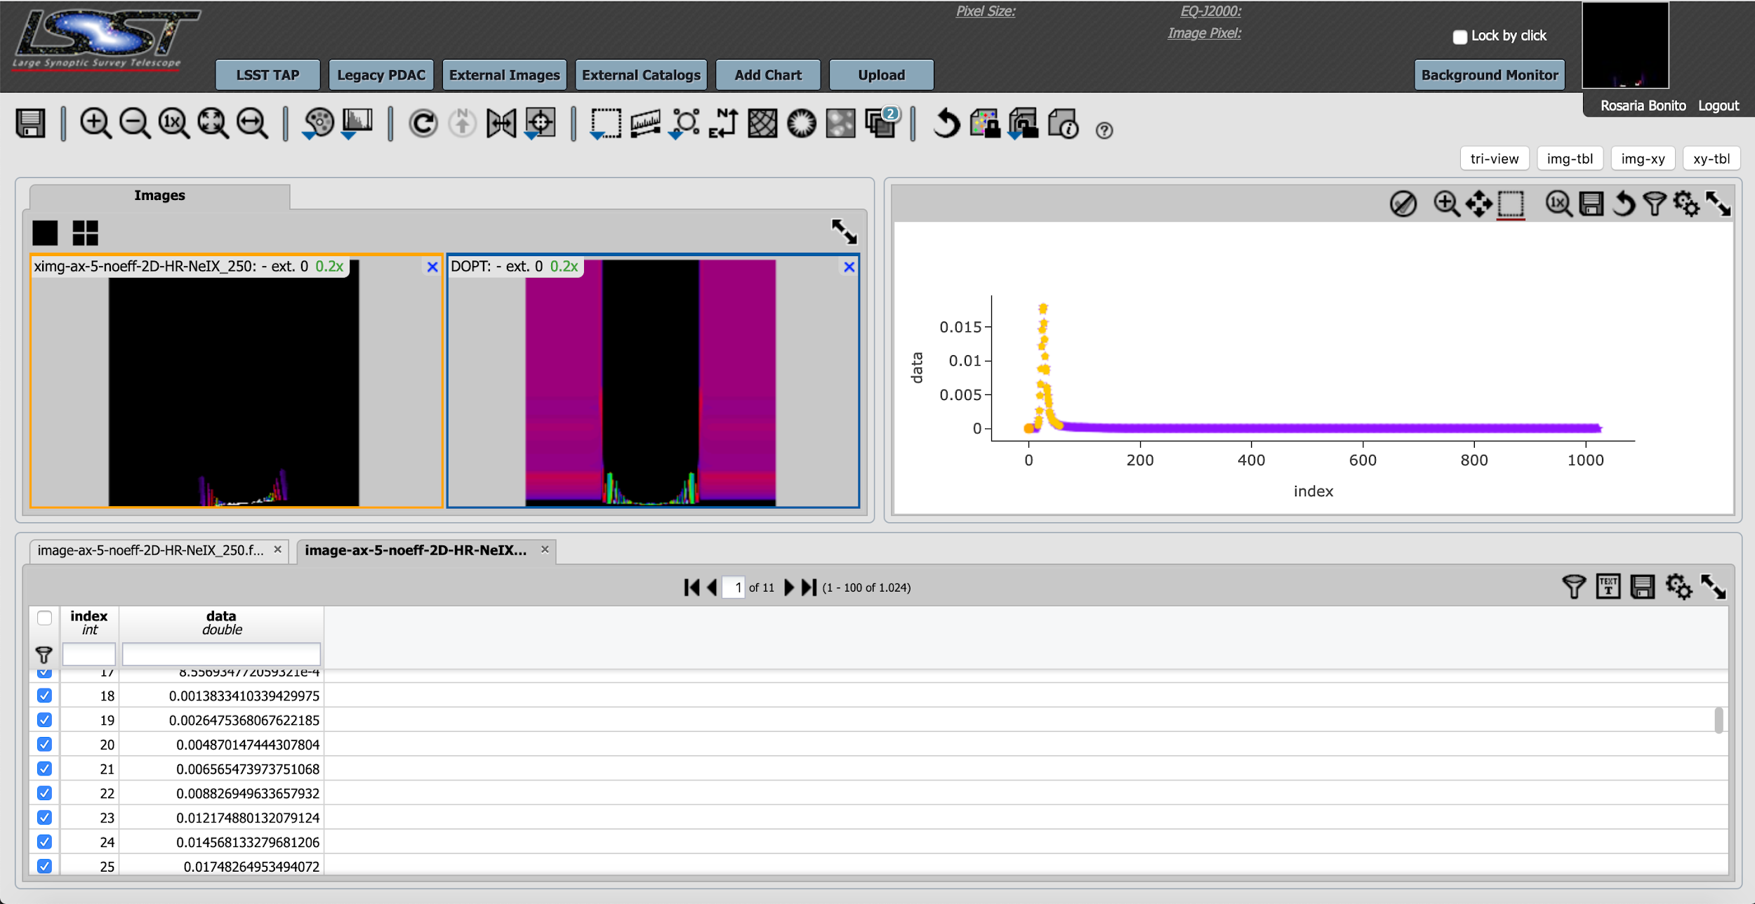
NUMERICAL SIMULATIONS
YSO-ALESA
method
Ne IX – temperature map – total emission
(Bonito et al. in prep. )
Rosaria (Sara) Bonito
Notes:
YSO-ALESA tool: Accretion lines emission synthesis with local absorption tool for YSOs
We will here focus our synthesis of the radiation emanating from the modelled accretion impacts on the emission around the CIV doublet in UV, and of the OVII and NeIX triplets, in X-rays, in particular exploring the effect of the local absorption on the emission at different wavelengths. The aim is to evaluate how the effects of this local absorption are changing when the structure of the accretion impact is observed at different inclinations with respect to the LoS (5, 45, and 60 deg = 30, 45, 85 in Bonito et al. 2014).
We find that the main contribution to the local absorption is the unperturbed accretion stream itself, and that different energy ranges suffer the absorption at a different level.
This is shown in Fig. 2, 3, and 4, where we have synthesized the emission in the OVII and NeIX for the X-ray band, as in Bonito et al. 2014, and in CIV for the UV band.
Comparing left panels and right panels in Fig. 2, 3, and 4, it is evident that part of the emission is absorbed due to the role of the local absorption, and that the effect is different in different energy bands.
‹#›

Slide 28
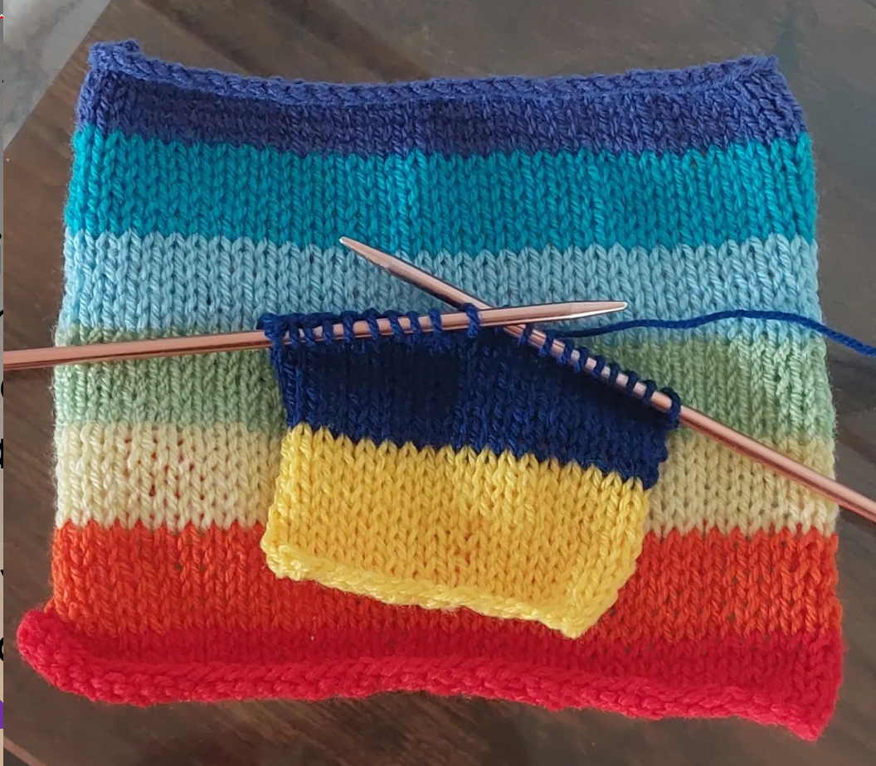
JEDI group
chair Sara (Rosaria) Bonito
- useful links to support Ukraine
- funded projects (Kick-starter Grant):
1) JEDI for trainings (Bonito-Bianco)
2) faculty-student mentoring program (Cucchiara et al.)
3) Sonification of Rubin LSST data (Bianco, Eggl, Bonito et al.)
- participation to NSBP (several members of JEDI): funded by LCO
- documents to recruit people to job positions

Slide 29
RUBIN OBSERVATORY
GROUPS/TASK FORCE INFO
Get in the conversation on Slack:
#tvs-ndev
#tvs-dp0
#tvs-jedi
E-mail: rosaria.bonito@inaf.it
Join a TVS Task Force and subgroup (see also information on the Justice, Equity, Diversity, and Inclusion group):
https://lsst-tvssc.github.io/
Rosaria (Sara) Bonito – INAF - Observatory of Palermo (Italy)

Slide 30
AGENDA
RUBIN OBSERVATORY
Martedi’ 21 giugno:
10:00 - 10:30: introduzione al workshop (Sara e Laura)
10:30 - 11:00: talk Sabina: lavoro finora
11:00-11:30 coffee break/foto di gruppo
11:30 - 12:30: 2 talk (Teresa - Alessio: EXors, FUors, episodic accretion)
12:30 - 13:00: discussione guidata da Sabina: prospettive future
13:00 - 14:00: pausa pranzo libera
14:00 - 16:30: hands-on
16:30 - 17:00: coffee break
17:00 - 18:00: discussione/hands-on
Mercoledi’ 22 giugno:
09:30 - 10:00: Laura (colors of YSO variability)
10:00 - 10:30: Sara (Rubin LSST: LC & 3D)
10:30 - 11:00: Salvatore (3D)
11:00 - 11:30: visione Star Blast in VR
11:30 - 12:00: coffee break
12:00 - 13:00: 2 talk (Loredana: Gaia; Mario: NGC 2264)
13:00 - 14:00: pausa pranzo libera/visita guidata al Museo
15:00 - 16:30: discussione/hands-on
16:30 - 17:00: coffee break
17:00 - 17:30: considerazioni finali e prospettive future (Sara&Laura)
Fine del workshop
Rosaria (Sara) Bonito – INAF - Observatory of Palermo (Italy)

Slide 31
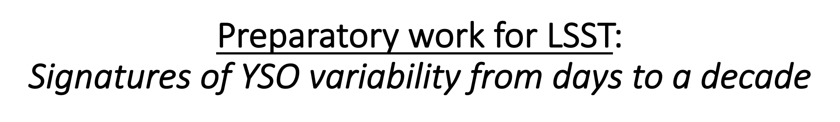
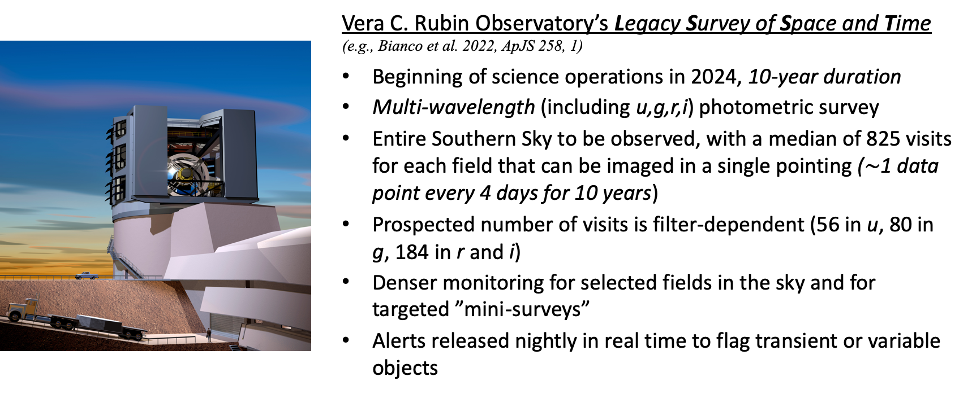

Slide 32
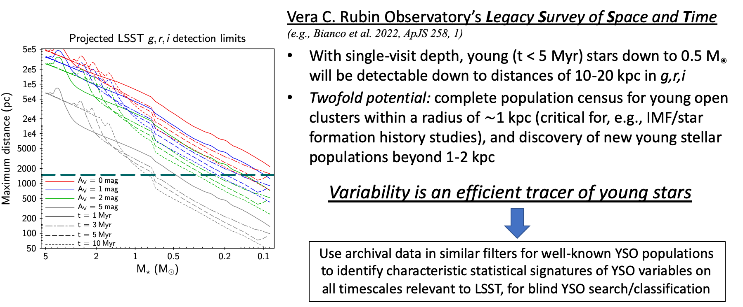

Slide 33
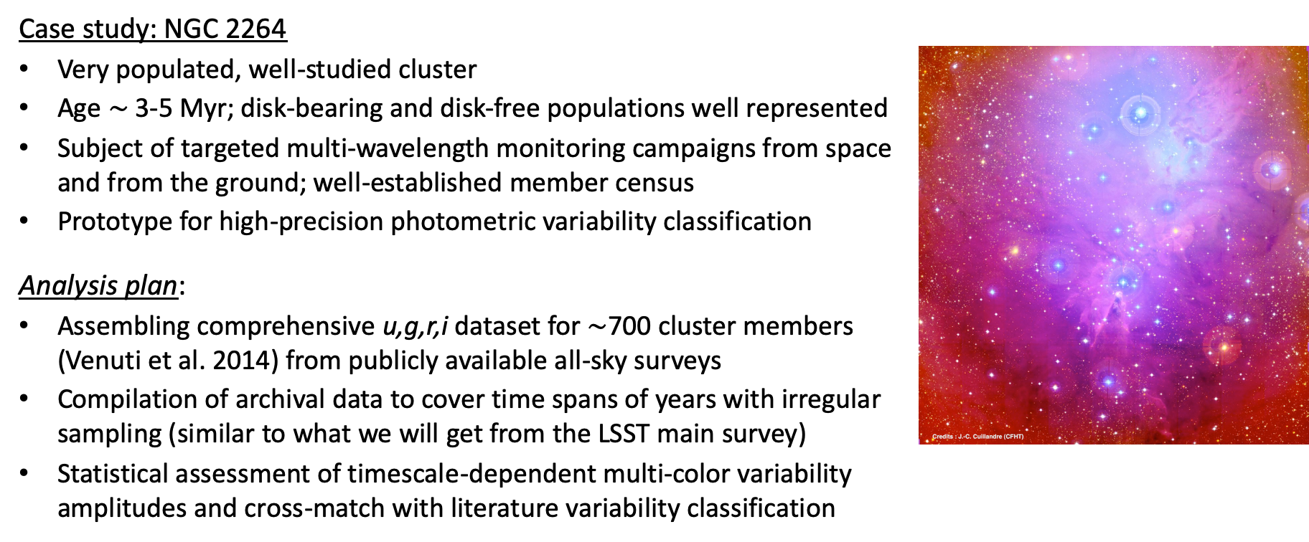

Slide 34
